Slide 1

Exploratory Data Analysis of CCARPRICE
Batch no:324
Team Members:
Ravi Prakash
Shabnam Patibandla

Slide 2
INTRODUCTION
The automotive industry is shaped by a variety of factors that influence vehicle pricing, including brand reputation, design preferences, and advancements in fuel technology. This project aims to analyze car prices through the lens of brand, body type, and fuel type, providing a comprehensive view of market trends and pricing dynamics. By exploring similarities and differences among models, brands, and categories, the study seeks to uncover insights into how these factors affect vehicle value.

Slide 3
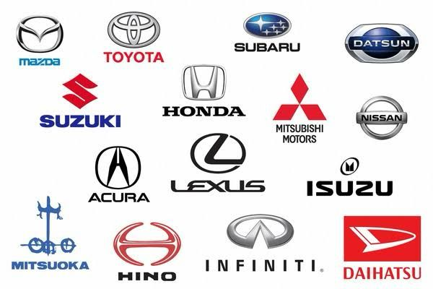
OBJECTIVE
Identify the average price of cars by brand, body type, and fuel type.
Compare prices of similar models across brands.
Compare the pricing of different body types to determine trends.

Slide 4






Tools Used:
NumPy
Pandas
Libraries Used:
Matplotlib
Seaborn
Plotly
Web Scraping:
BeautifulSoup

Slide 5
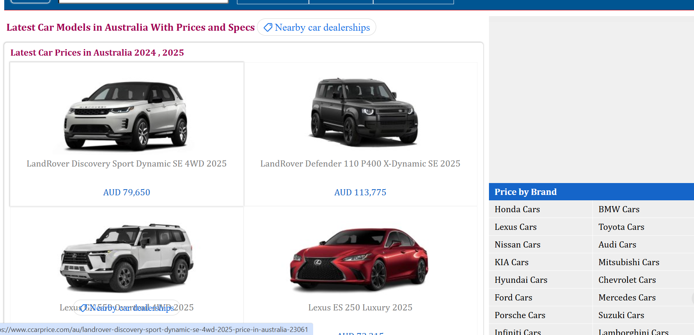
WEBSITE
We performed Scrapping on CCARPRICE Website to get the data.
Website Link : https://www.ccarprice.com/au/

Slide 6
DATA PREPARATION
Web Scraping :
By Using Request Library , We extracted the HTML code of the page.
By using the BeautifulSoup BS4 Library , We parse and navigate the HTML Structure of a webpage in a simple Efficient Way.
BeautifulSoup :
Easy to use: Simple API for common scraping tasks.
Handles broken HTML: Can parse and clean malformed HTML.
Powerful search: Easily find elements by tag, class, id, or attributes.
Efficient parsing: Quickly navigate and extract data from complex web pages.

Slide 7
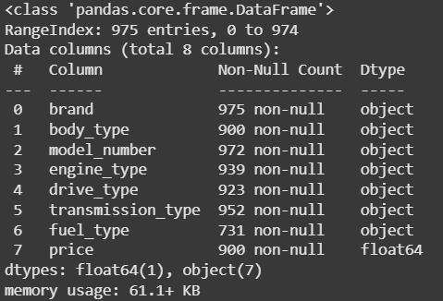
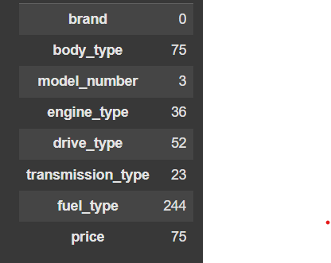
EXPLORATORY DATA ANALYSIS
Inspecting the Data :
Data frame contains 975 Rows and 8 columns

Slide 8
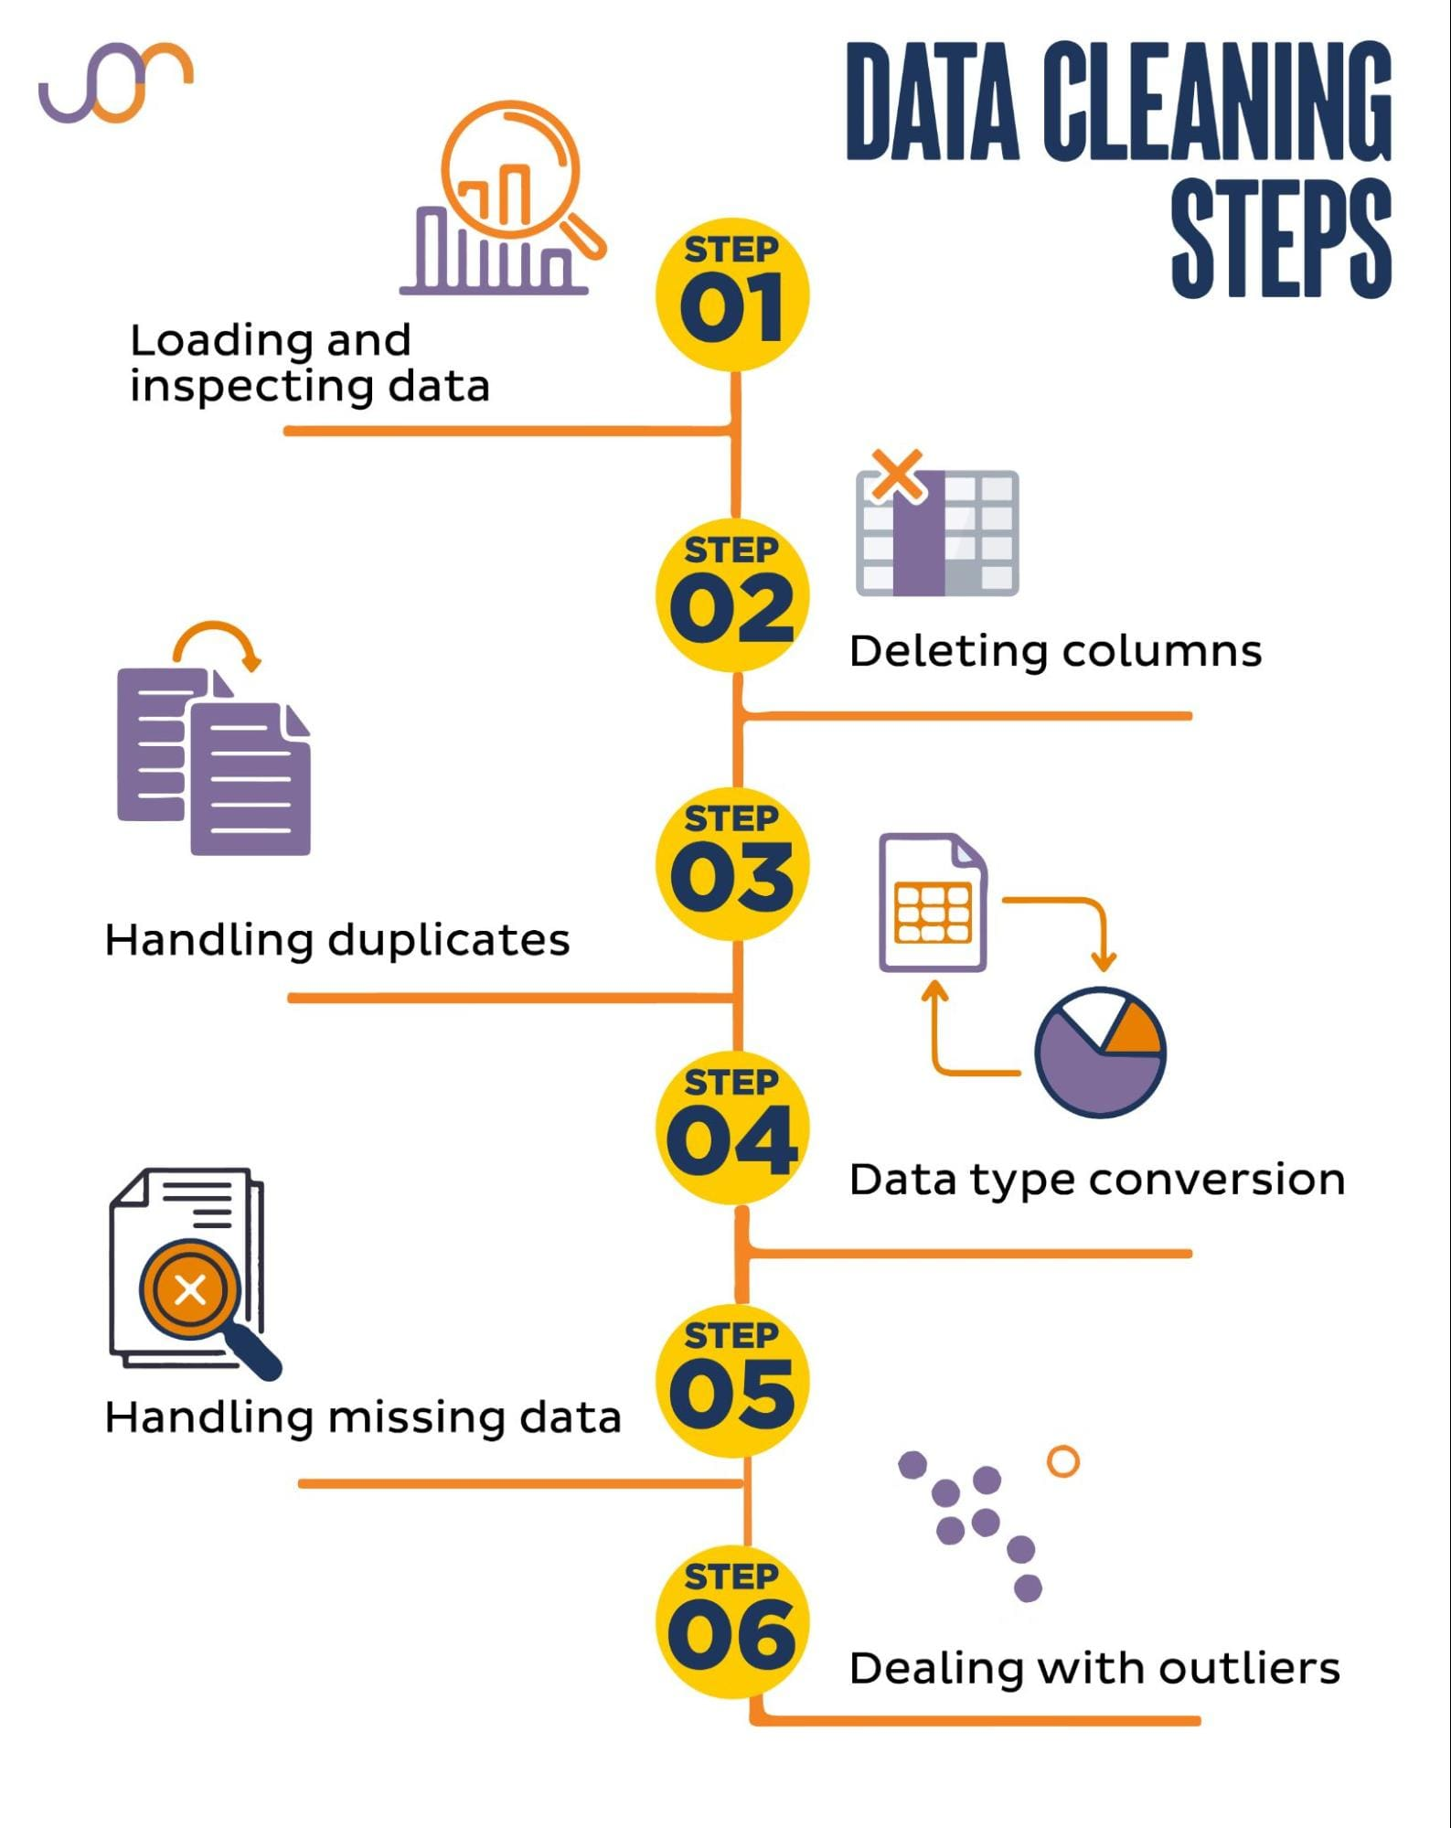
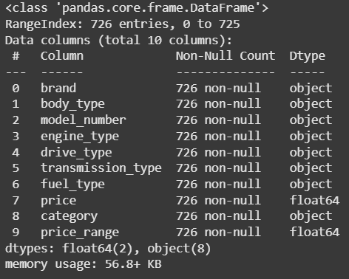
Data Cleaning:
After data cleaning process done
Data frame contains 726 Rows and 8 columns

Slide 9
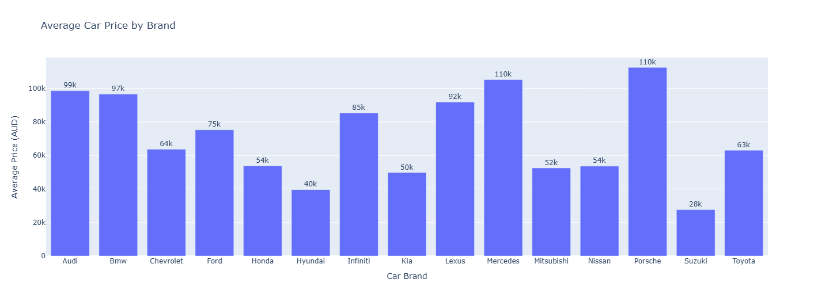
Average price analysis by brand & body type
There's a significant variation in average car prices across different brands.
High-End Brands: Mercedes and Porsche have the highest average prices, indicating they are luxury brands.
Mid-Range Brands: Brands like Audi, BMW, and Lexus fall in the mid-range price segment.
Budget-Friendly Brands: Chevrolet, Ford, Honda, and Hyundai offer cars at more affordable price points

Slide 10
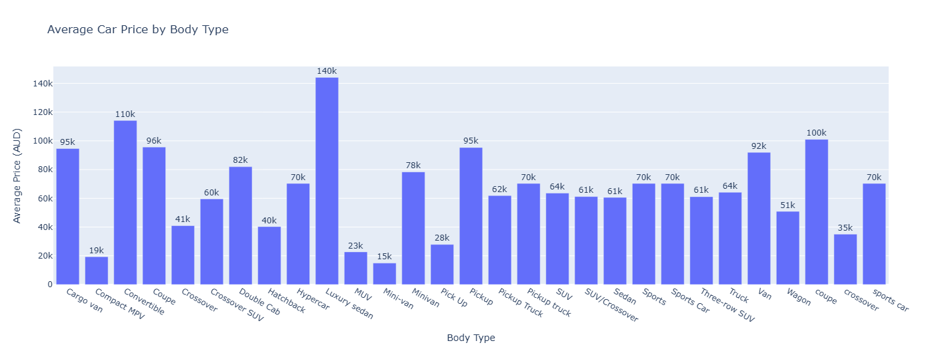
The graph provides a quick overview of how different car body types are positioned in terms of average pricing, ranging from budget-friendly options to luxury vehicles.
Factors like car model, features, and brand can influence the average price within each body type.

Slide 11
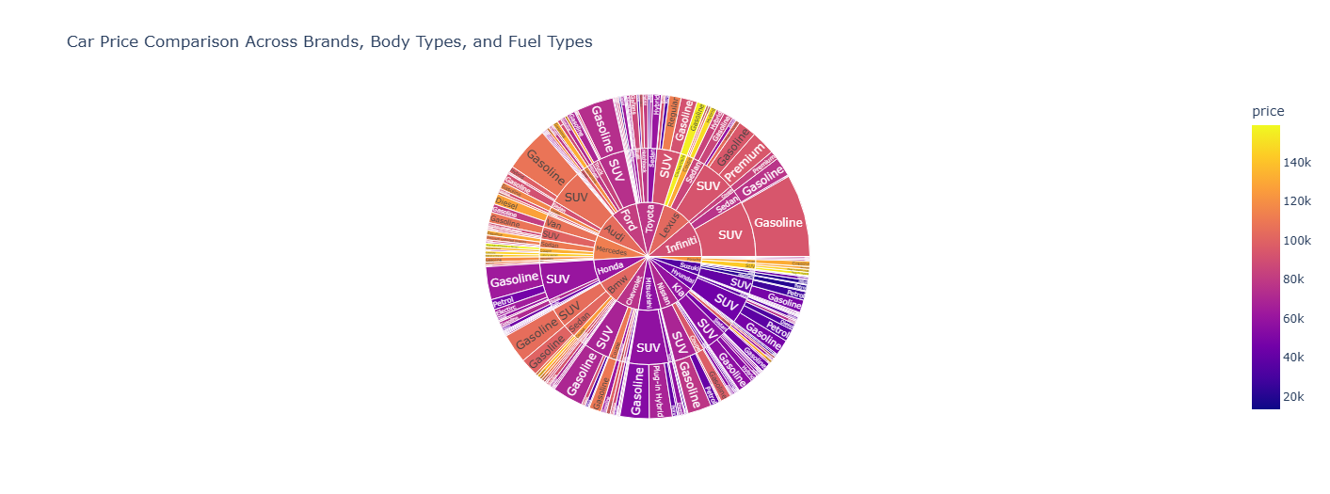
Price Comparison Across Brands
Price Variation: There is a significant price difference between brands, body types, and fuel types. Gasoline SUVs and Hybrids tend to have higher average prices compared to other configurations.
SUVs and Hybrids are generally more expensive than sedans and hatchbacks.
Hybrid and Electric vehicles tend to have higher average prices compared to gasoline-powered cars.

Slide 12
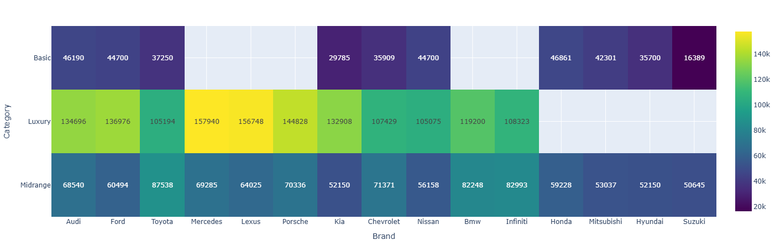
Car price by brand and Category
The graph shows the average prices of cars across different brands and categories.
Luxury cars have significantly higher average prices compared to mid-range and basic cars, reflecting their higher features and premium status.

Slide 13
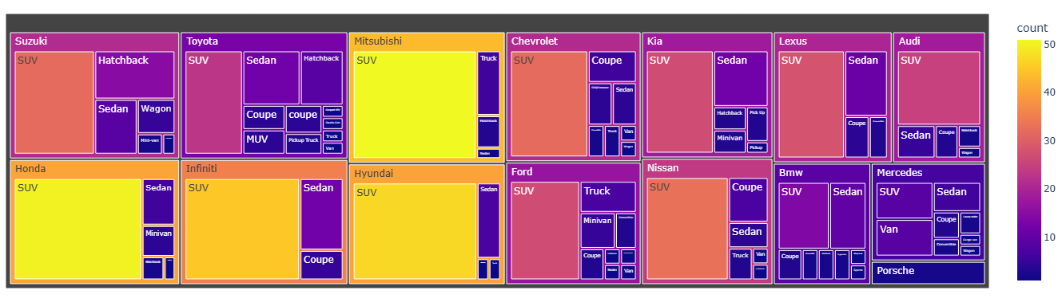
Distribution of Body Types Across Brands
SUVs are the most common body type across most brands, indicating their popularity in the market.
Some brands, like Suzuki and Mitsubishi, have a higher proportion of SUVs compared to others. Brands like Honda and Infiniti have a mix of SUVs, sedans, and other body types.

Slide 14
Conclusion:
Price Segmentation:
The market is segmented based on price, with luxury, mid-range, and budget-friendly options.
SUVs are the most popular body type across various brands.
Gasoline-powered vehicles are still dominant, but hybrid and electric vehicles are gaining traction.
Popular Trends:
SUVs have become increasingly popular across various brands.
There is a growing demand for hybrid and electric vehicles, especially in developed markets.

Slide 15


Slide 16

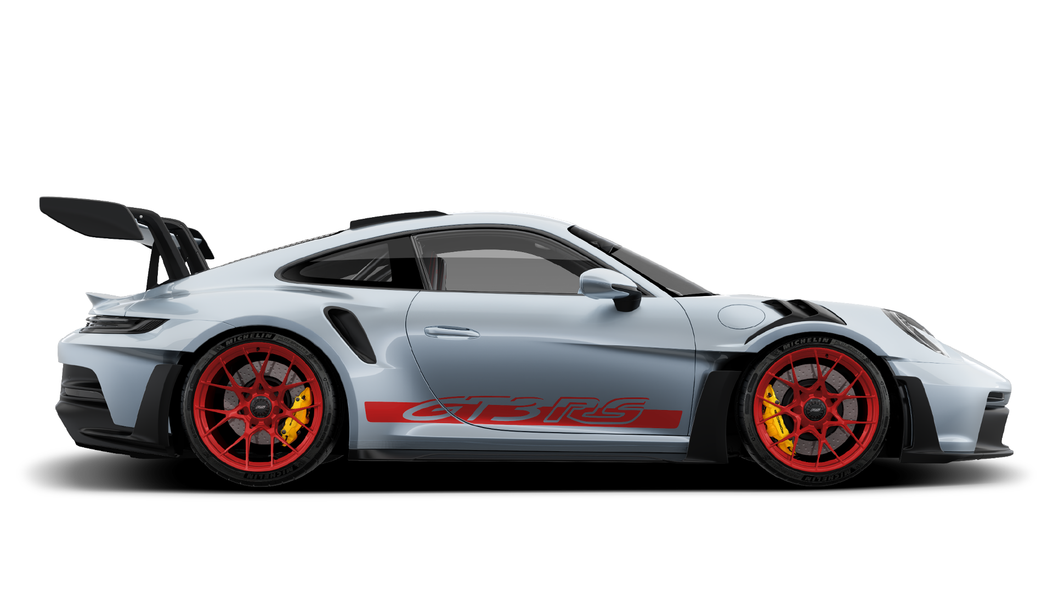
THANK YOU

